Slide 1
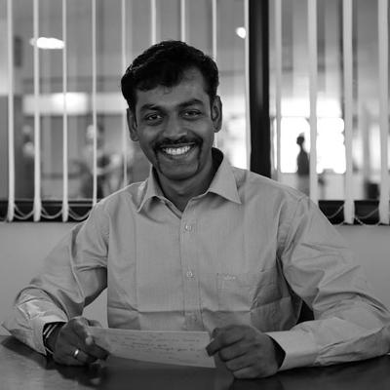
INJURY
PREVENTION
Dr.Gladson Johnson

Slide 2
ABCDE
in running
Notes:
https://www.udemy.com/chris-anderson-on-public-speaking/
Chris Anderson

Slide 3

ABCDE
ARM SWING
Bharat
mane
Notes:
So a great way to think about "a talk" is as a journey. You, the speaker, are going with your audience on a journey of discovery together.
So what makes a journey successful?
It's really just two simple things.
The first is you obviously have to start where the audience is.
You start on the journey together. So that means you have to be putting yourself in their shoes and planning to use their language, their assumptions, not your own starting assumptions.
And then each step of the journey needs to be both possible and desirable.

Slide 4
From the session
Running is based on push & pull
Legs must push with less muscles
Hands pull with more muscles
From the internet
Swinging arms counterbalance the momentum of a person’s legs, providing stability to the runner
Swinging your arms uses 3% less energy than keeping your hands behind your back, 9% less energy than folding your arms over your chest
By balancing the body as it moves, arm swing helps reduce overall energy expenditure, propel you forward and improve overall running rhythm by helping to lift the body off the ground with each stride. This helps relieve stress from the lower body and improve pelvic rotation, making things easier on your legs, too.
Bharat
mane

Slide 5

through line
Bharat
mane
Notes:
There’s a helpful word used to analyze plays, movies, and novels; it applies to talks, too.
It’s “through-line,” the connecting theme that ties together each narrative element.
Every talk should have one.
https://www.fastcompany.com/3059547/ted-talk-masters-teach-you-how-to-tell-a-story-that-actually-means-something

Slide 6
Arm swing
Bend your elbows: To improve efficiency, keep your elbow bend in the 80–100 degree range. Keep your elbows tucked and close to your sides in the same plane of motion, never allowing them to swing across the body.
Swing from the shoulders: When you move your arms, swing them from the shoulders and not from the elbow. Try not to lift your shoulders up or down during the swing, which helps remove tension and stay relaxed. Your shoulders should also not move forward and backward. Aim instead to keep the shoulder in a fixed position.

Slide 7
Arm swing
Relax your hands: If you clench your hands into a fist, your upper body will be tight and it will be harder to keep your shoulders relaxed. If you relax your hands, the arms and shoulders will follow suit.
Concentrate on arm drive: The forward swing of the arm comes most naturally; where most runners can improve their arm movement is behind the body. By concentrating on pushing your elbow back, the forward motion happens on its own. While it takes some getting used to, and may feel initially like you’re working harder, increasing the drive of your arms takes strain off your legs and makes it easier to lift your feet.

Slide 8
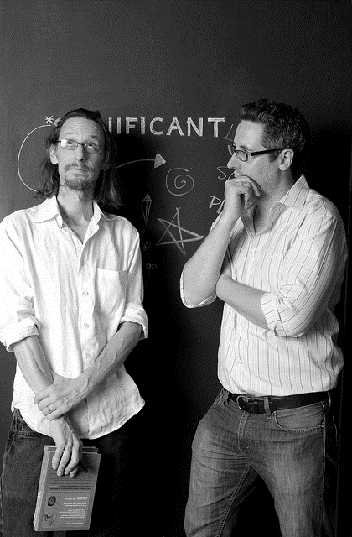

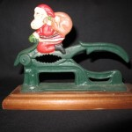

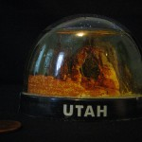





eBay Project
Significant Objects, a literary and anthropological experiment devised by Rob Walker and Joshua Glenn, demonstrated that the effect of narrative on any given object’s subjective value can be measured objectively
Rob Walker (L) and Joshua Glenn
https://significantobjects.com/
Bharat
mane

Slide 9
$ 129
$ 8000
Bharat
mane
Notes:
The cost of a poor PowerPoint presentation is staggering. Ian Parker in The New Yorkermagazine states that according to Microsoft estimates, there are more than 30 million PowerPoint presentations made each day. If we assume some relatively conservative meeting parameters of four people per presentation, a half-hour presentation on average and the wasted time due to a poor presentation is one-quarter of the presentation time, we arrive at a waste of 15 million person hours per day. At an average salary of $35,000 per year for those attending the meeting, the cost of that wasted time is a staggering $252 million and change each day.soft estimates, there are more than 30 million PowerPoint presentations made each day.

Slide 10

What doesn’t work
The sales pitch
The ramble
ORG BORE
Inspiration performance
Bharat
mane
Notes:
The first is the ramble.
So many speakers think that they can just come and wing it.
They come under-prepared to a speaking occasion and they
just talk about one thing that's on
their mind and then they shift to another and they go,
oh, yes, and another thing that I just must mention before I stop
is and the audience doesn't know where they are heading.
There's no connection between these different parts.
The speaker may think that, hey,
all of this is interesting,
I'm an interesting person,
look at me, the audience experience is just one of deep frustration. Don't ramble.
You owe it to our audience to prepare a connected talk.

Slide 11
How do you structure a talk
to be disciplined
The ramble
ORG BORE
Inspiration performance
Bharat
mane
Notes:
So how do you structure
a talk that is going to be successful at communicating an idea that matters?
The number one key is to be disciplined here.
It's to cut out everything that does not relate directly to that idea.
It's a total trap that people fall into when they've got 20-30 minutes to speak.
They want to cram in everything that they're excited about right now. Who wouldn't?
The trouble with that is that it leads to
a chaotic talk and it leads to nothing being explained in depth.
To make an idea land it has to be unpacked carefully.
There's a lot of context that you have to give and that means
you have to cut out everything except that one idea.
And it really is hard.
It's like when you've planned your talk, cut it in half,
cut out half of the topics that you've planned to talk
about and just make yourself ask again,
what is the key thing I'm trying to say here?
Does this thing honestly add to that?
If it doesn't, get rid of it.
That thing that you are left with,
that becomes the through line of your talk.
Now this is a really important concept, a through line.
This is, you can think of it as almost like a cord that runs through
the talk that every part of the talk is attached to in some way.
The cord really represents the core idea that you want to share.
But all the different other pieces attach in,
so there might be an introduction,
an early anecdote that showed how you got interested in this topic,
some historical context as to why it actually matters.
Some attempts to solve the problem that went wrong either by others or by you.
Some examples of what it took to get to a solution and so forth.
And then at the end perhaps some implications,
but you can think of all these as additional pieces attached to a through line,
that through line is the structure of your talk.
And it's really helpful to think of every talk as having that through line,
that'll help you decide whether something should be included or not.
So every successful TED talk,
for example, has its own through line.
When Berne Brown gave her talk,
I would describe her through line as
vulnerability is something to be treasured, not hidden from.
That single idea, every part of that talk,
attached to in some way.
Ken Robinson spoke about how creativity really matters
for our kids' future and it's not being nurtured properly at school.
But through lines can be simpler.
Elora Hardy gave a talk about how building from bamboo could be really beautiful.
So it's not like a complex idea.
It's an aesthetic idea more, but it still,
it was an idea which informed every single part of her talk.

